Slide 1


Procurability-Aware Design Space Exploration
ECE Undergraduate Research Symposium
Lin Chuan Lee
Advisor: Rakesh Kumar

Slide 2


Motivation
ELECTRICAL & COMPUTER ENGINEERING
GRAINGER ENGINEERING

Slide 3
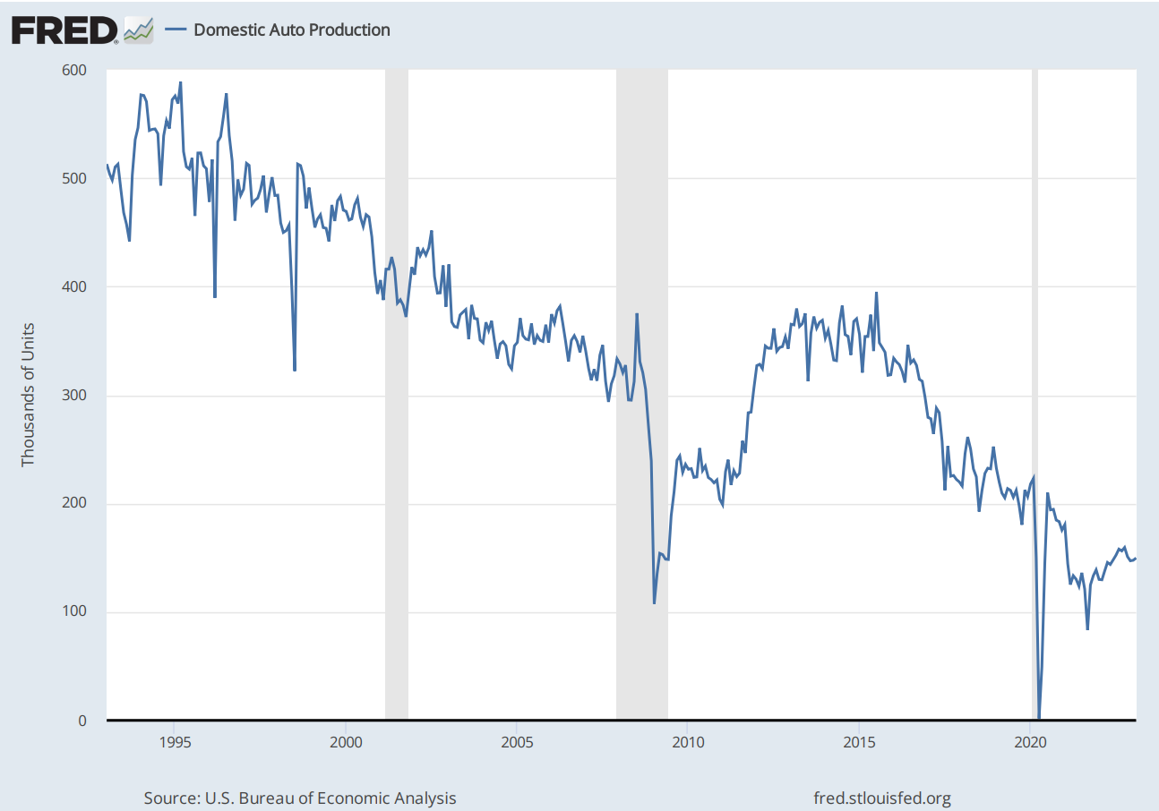
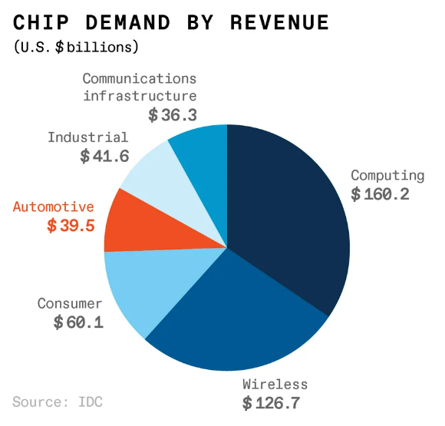
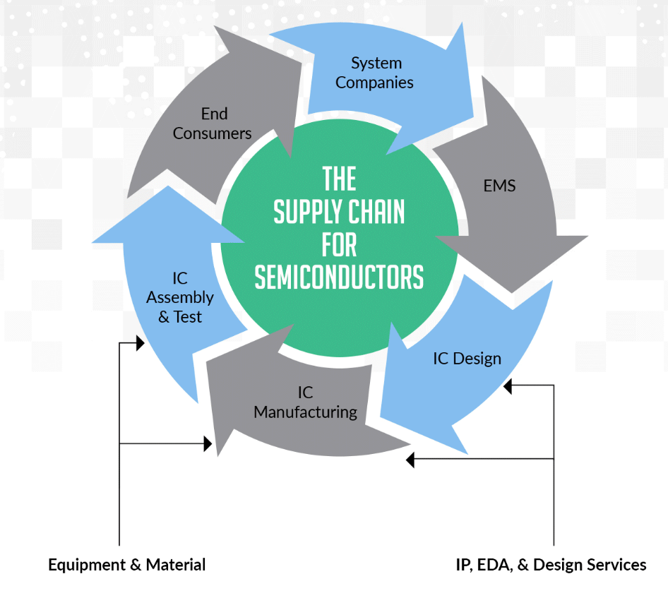
Motivation
Procurability as a first-order design metric.
Worldwide chip shortage in 2020 affected more than 169 industries.
Chip shortages are likely to reoccur in the future since the semiconductor industry faces unpredictable demand and supply.
Designing with Procurability in mind help overcome supply chain disruptions.
Use readily-available components with multiple suppliers.
Use standard architectures and interfaces.
ELECTRICAL & COMPUTER ENGINEERING
GRAINGER ENGINEERING

Slide 4
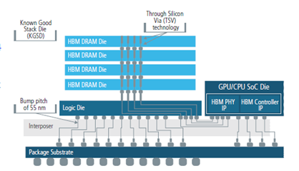
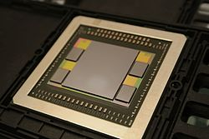



Motivation
Main Memory in Modern Computing System
Main memory bandwidth is a major factor influencing performance of modern computing systems.
Conventional main memory implemented using off-chip DDR DIMMs.
Emerging High Bandwidth Memory (HBM) enables on-chip integration of main memory through TSVs and silicon interposers.
HBM offers higher bandwidth, lower power consumption, and smaller form factor.
HBM has low procurability due to the limited number of suppliers and high integration cost.
The goal of this work to explore highly procurable design points that replace HBM with DDR memory at comparable performance and cost.
Compensate for bandwidth difference by varying L3 capacity, number of memory channels, and memory frequency
ELECTRICAL & COMPUTER ENGINEERING
GRAINGER ENGINEERING
Notes:
HBM has been used on GPUs and on some CPUs such as Intel’s Sapphire Rapids.

Slide 5
Design Space Exploration (DSE)
Framework
ELECTRICAL & COMPUTER ENGINEERING
GRAINGER ENGINEERING
Notes:
To do so, we first need to develop a DSE framework, which is a search-based analytical model of a generic multi-core system.

Slide 6
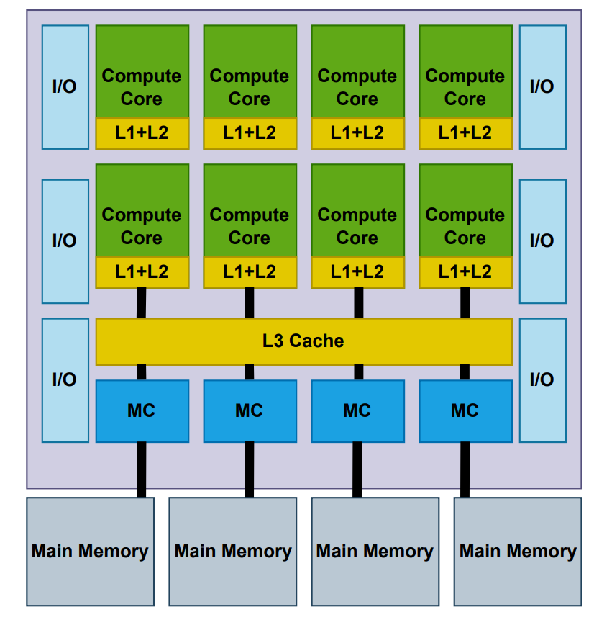
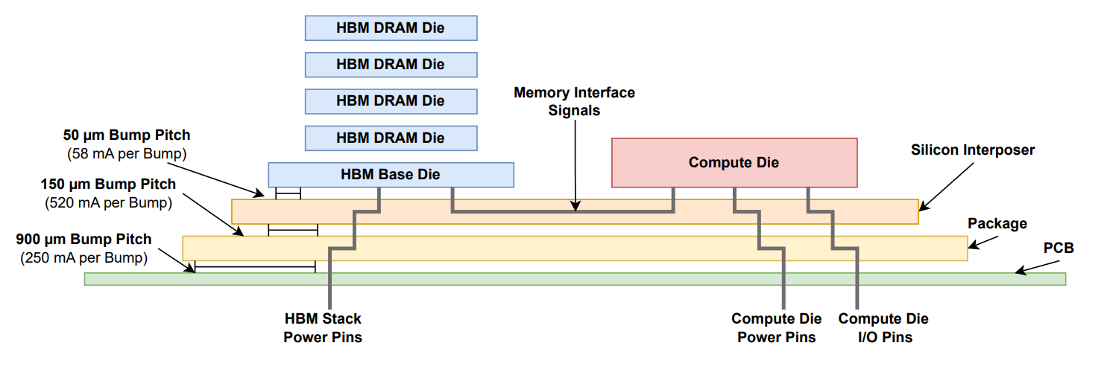
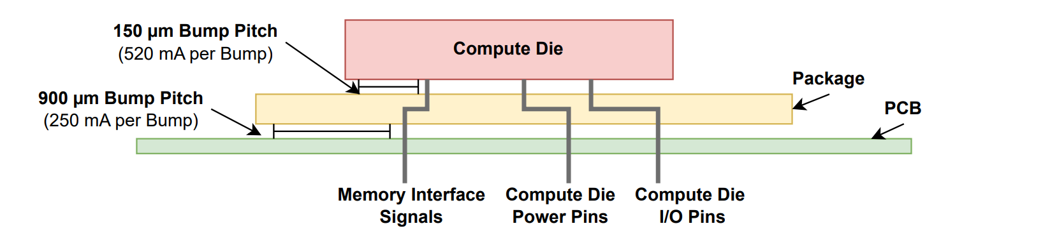
DSE Framework
View of the System
We assume a generic multi-core system with private L1 and L2 with shared L3.
Memory controllers for communication with main memory.
I/O controllers to interface with off-chip devices.
ELECTRICAL & COMPUTER ENGINEERING
GRAINGER ENGINEERING

Slide 7
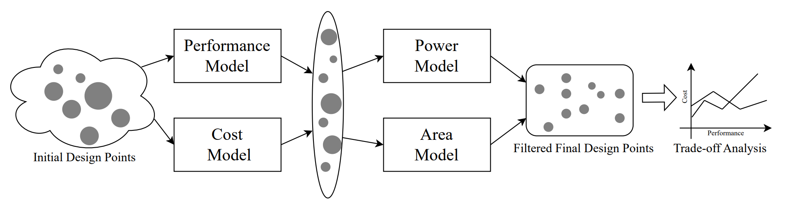
DSE Framework
Framework Setup
Developed analytical framework to model performance, cost, power and area.
ELECTRICAL & COMPUTER ENGINEERING
GRAINGER ENGINEERING
Notes:
Explain the purpose of each part of the model. We need the performance and cost to argue about design point trade-off. We need to power and area to filter out unrealistic designs. The area model also enforces some feasibility constraint such as whether the die is large enough to fit all the bumps or have enough perimeter for wire fanouts.

Slide 8
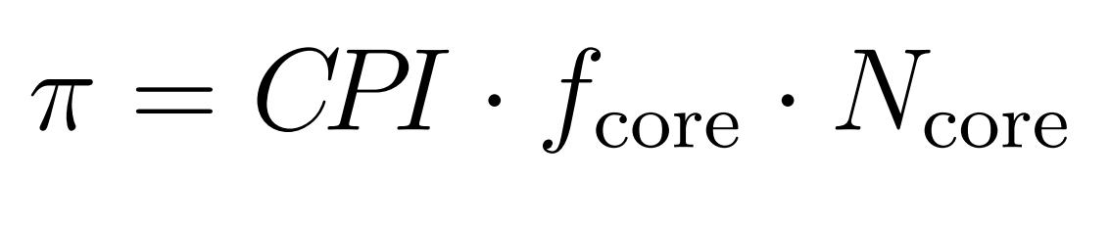
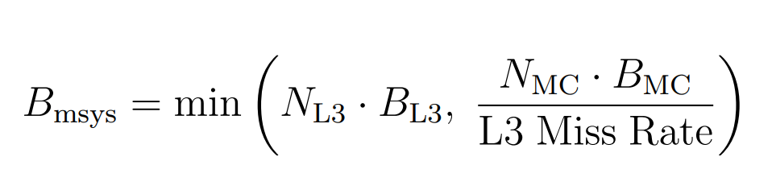
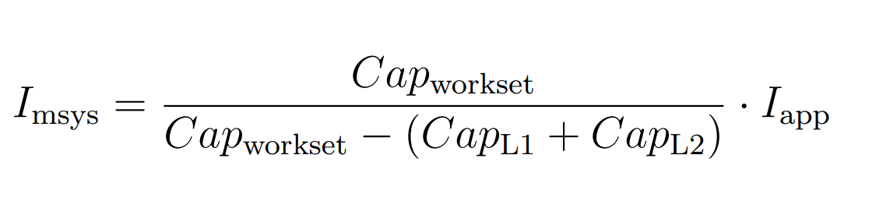
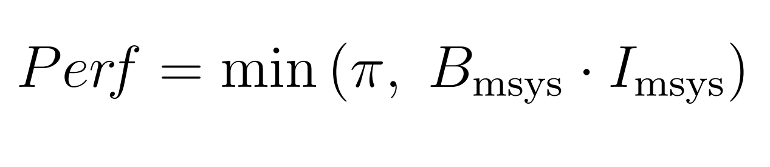
DSE Framework
Performance Modeling
Assumed independence between cores.
Used roofline model to estimate performance.
Cache hit rate determined by the relative size of the working set and the cache.
ELECTRICAL & COMPUTER ENGINEERING
GRAINGER ENGINEERING

Slide 9
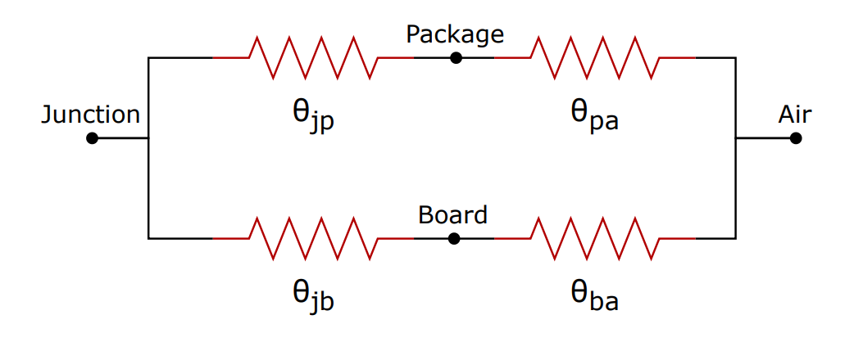
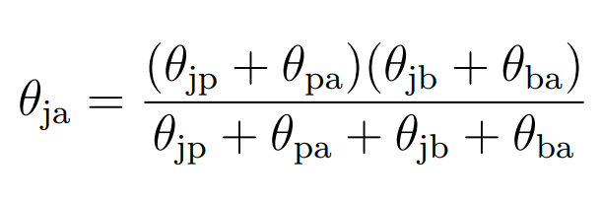
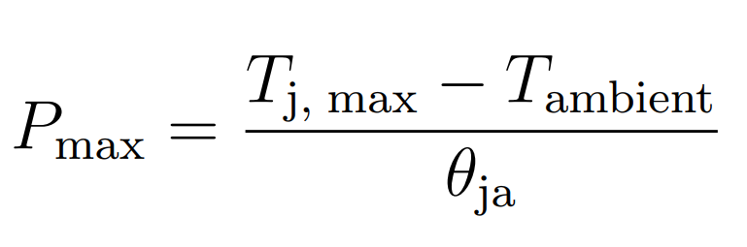
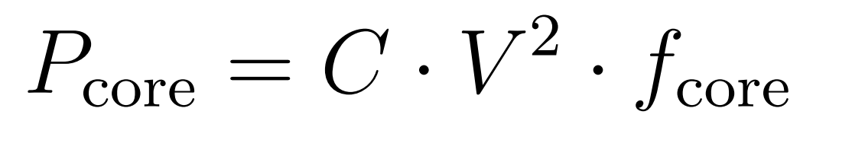
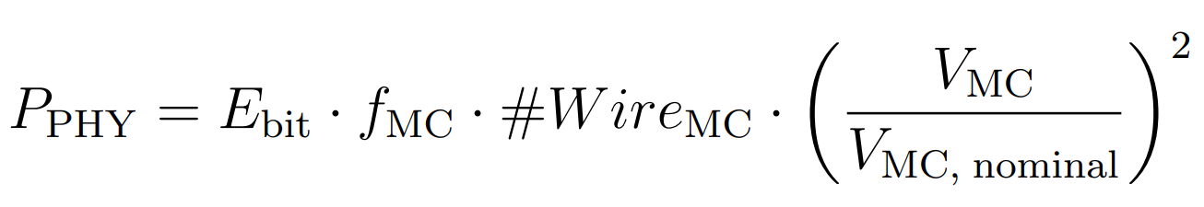
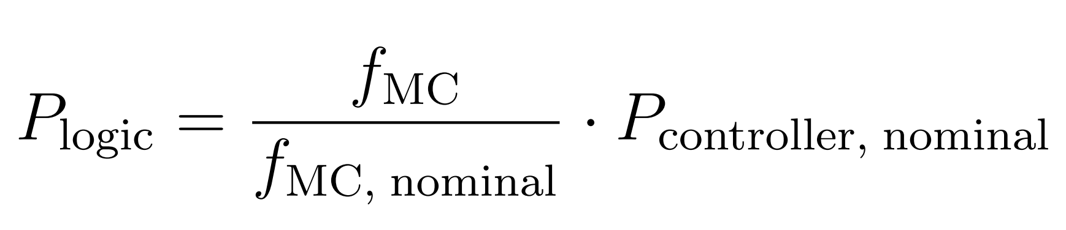
DSE Framework
Power Modeling
Assume the entire compute die is supplied at the same voltage level except the memory controller PHY.
Modeled DVFS for both the compute cores and the memory controller.
ELECTRICAL & COMPUTER ENGINEERING
GRAINGER ENGINEERING

Slide 10
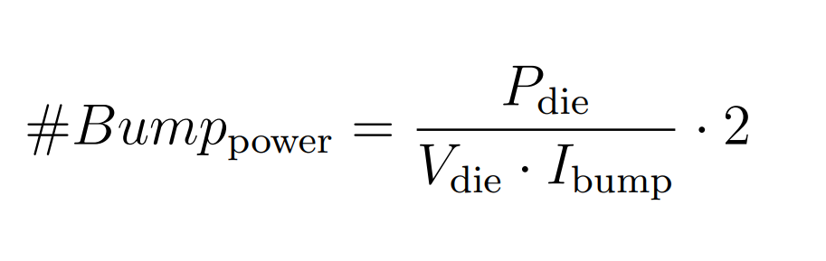
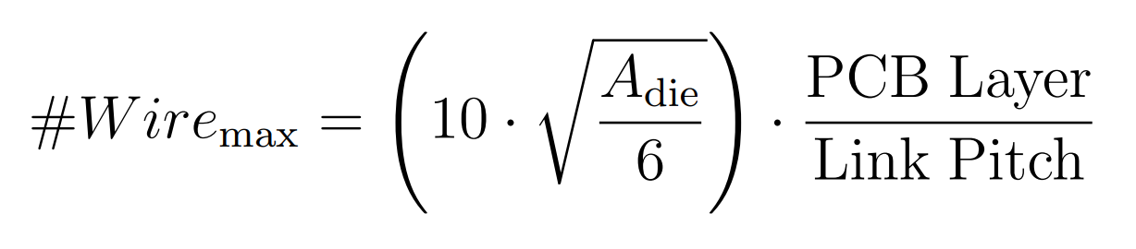
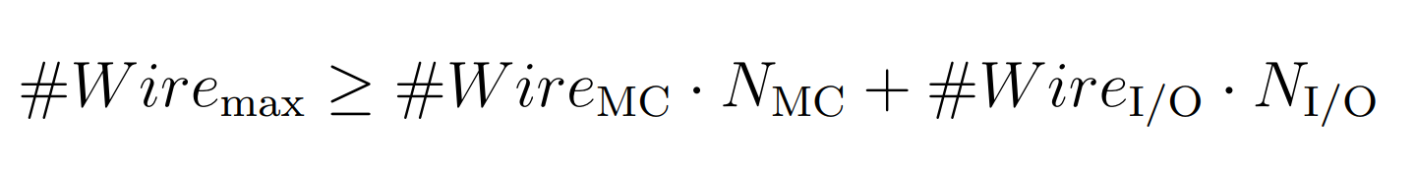
DSE Framework
Area Modeling
In addition to DVFS, compute core area are also scaled with frequency beyond a threshold to account for microarchitecture and low-level synthesis adjustments.
Logic and memory areas have different scaling ratio.
Used CACTI SRAM simulator to estimate L1/L2/L3 density.
Only considers design with < 1000 mm² area.
Compute die area must be large enough to fit bumps for power delivery, memory interface, and I/O. Add dead space otherwise.
Compute die perimeter must be long enough for wire fan out within package. We assume power delivery wires do not fan out for minimal routing distance.
ELECTRICAL & COMPUTER ENGINEERING
GRAINGER ENGINEERING

Slide 11
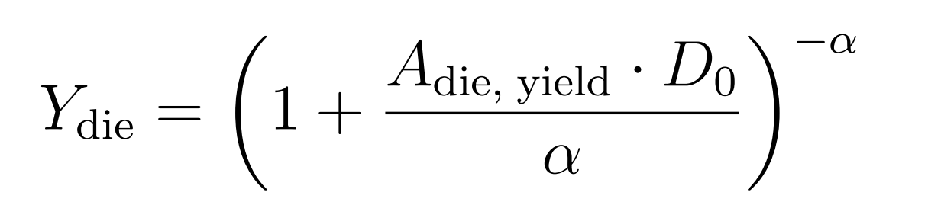
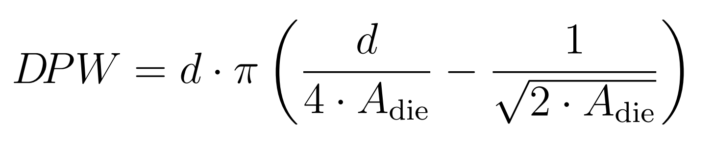
DSE Framework
Cost Modeling
Logic versus memory impact yield differently (easier to apply redundancy techniques on regular structure like caches to improve yield). Used CACTI to estimate percentage of cache area dedicated to SRAM cells.
Estimate yield for both compute die and silicon interposer with the negative binomial model.
HBM package have different area than DDR. HBM package need to supply power to HBM DRAM stack but do not need to expose memory interface pins.
ELECTRICAL & COMPUTER ENGINEERING
GRAINGER ENGINEERING

Slide 12
Results
ELECTRICAL & COMPUTER ENGINEERING
GRAINGER ENGINEERING
Notes:
To do so, we first need to develop a DSE framework, which is a search-based analytical model of a generic multi-core system.

Slide 13
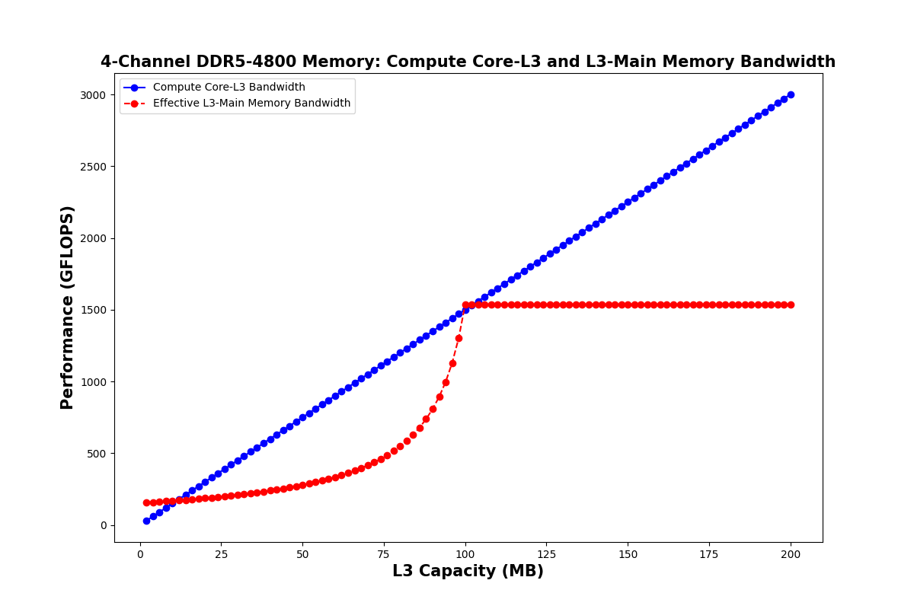
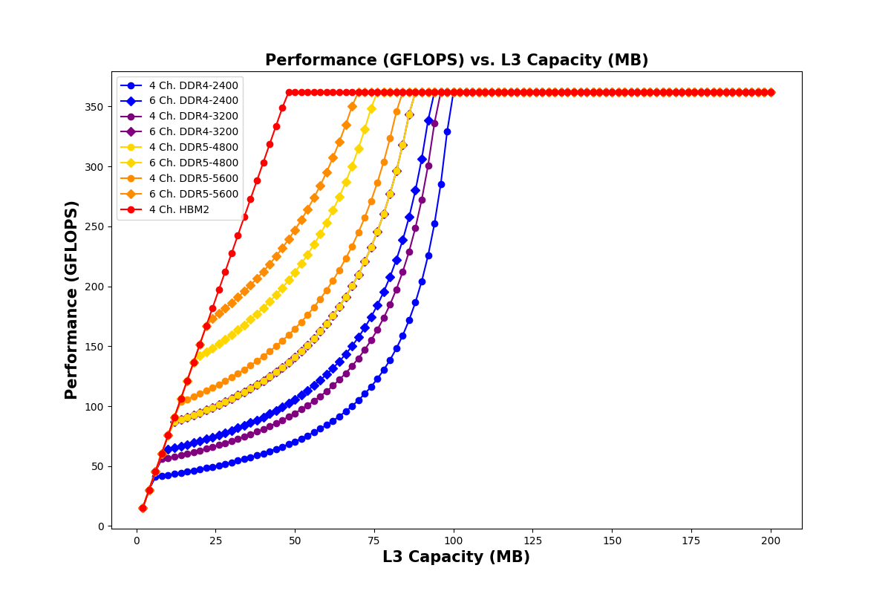
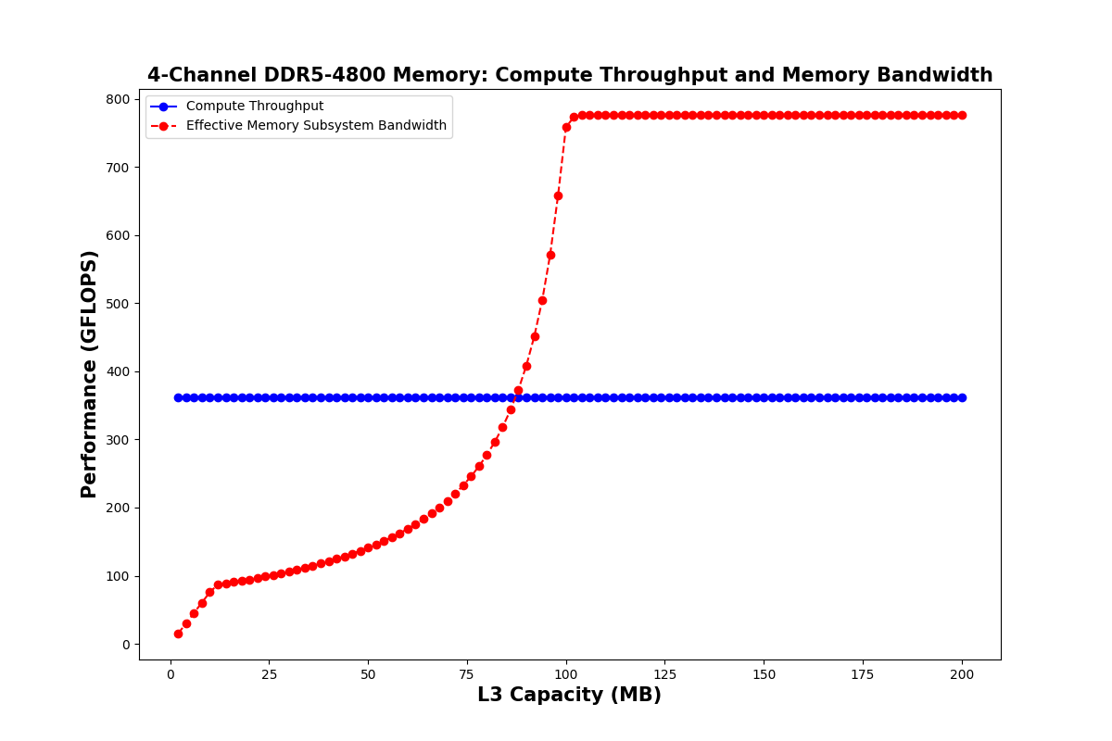
Results
Analyzing Performance Characteristics
We observed regions where the system performance is bounded by compute core-L3 bandwidth, L3-main memory bandwidth, and compute throughput.
ELECTRICAL & COMPUTER ENGINEERING
GRAINGER ENGINEERING

Slide 14
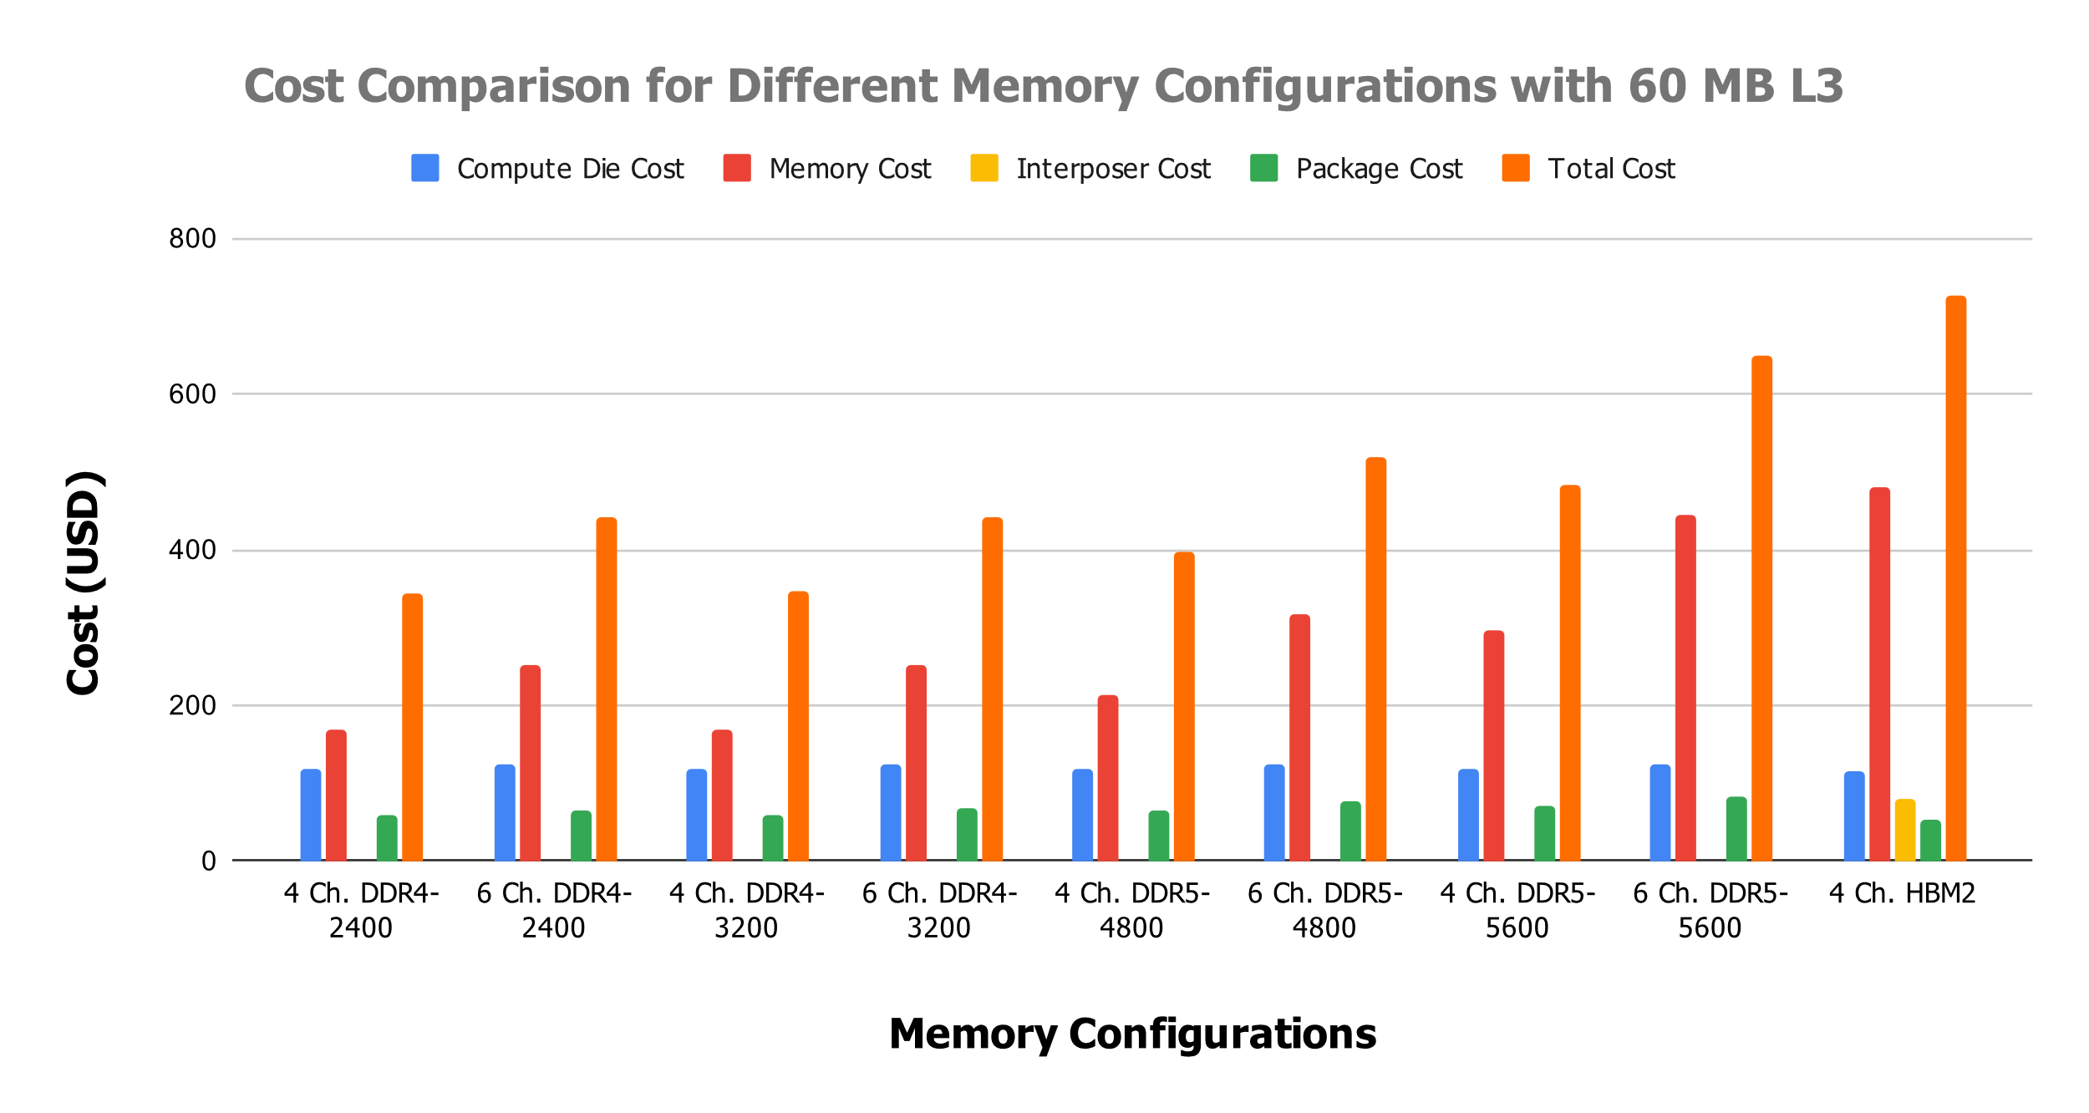
Results
Cost Composition Analysis for Iso-L3 Capacity
For the same L3 capacity, we observed that the reference HBM system has a higher memory cost and total cost but a lower package cost compared to any DDR systems.
ELECTRICAL & COMPUTER ENGINEERING
GRAINGER ENGINEERING
Notes:
Explain why HBM system has cheaper package? It is because (i) on-chip DRAM means memory interface wires do not need to leave the package so fewer package bumps (ii) the wide interface (1024 bits for HBM versus 32 bits for GDDR) means HBM can be clocked at a lower frequency and still have high bandwidth (iii) HBM has on-chip DRAM which means the amount of power required to signal a bit to main memory is 4.29x less than off-chip DRAM.
Both (ii) and (iii) reduce power consumption which means the package can be made cheaper.

Slide 15
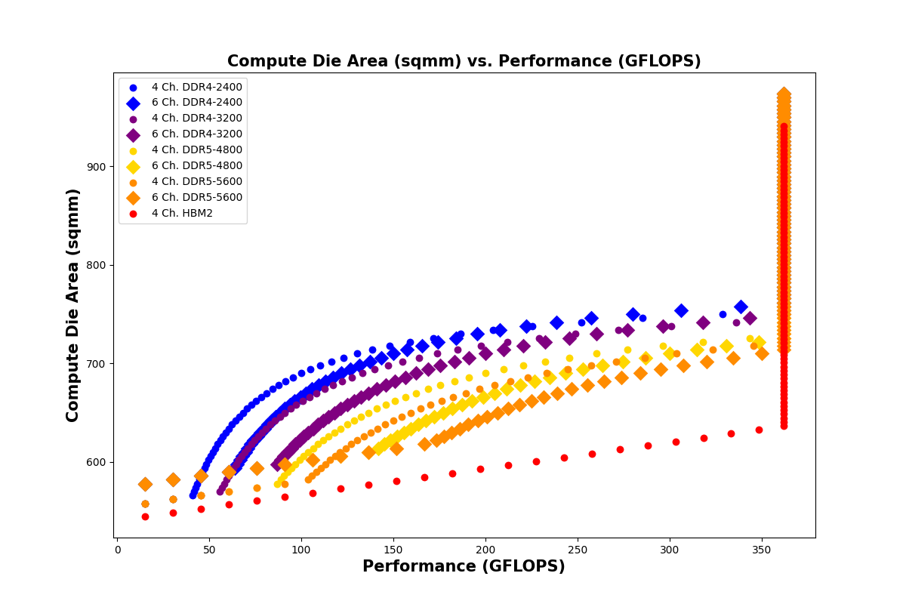
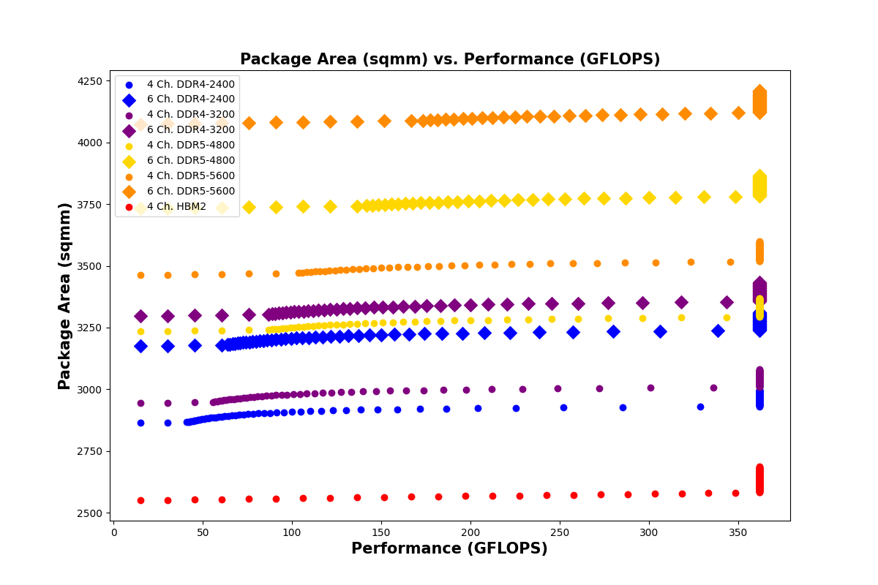
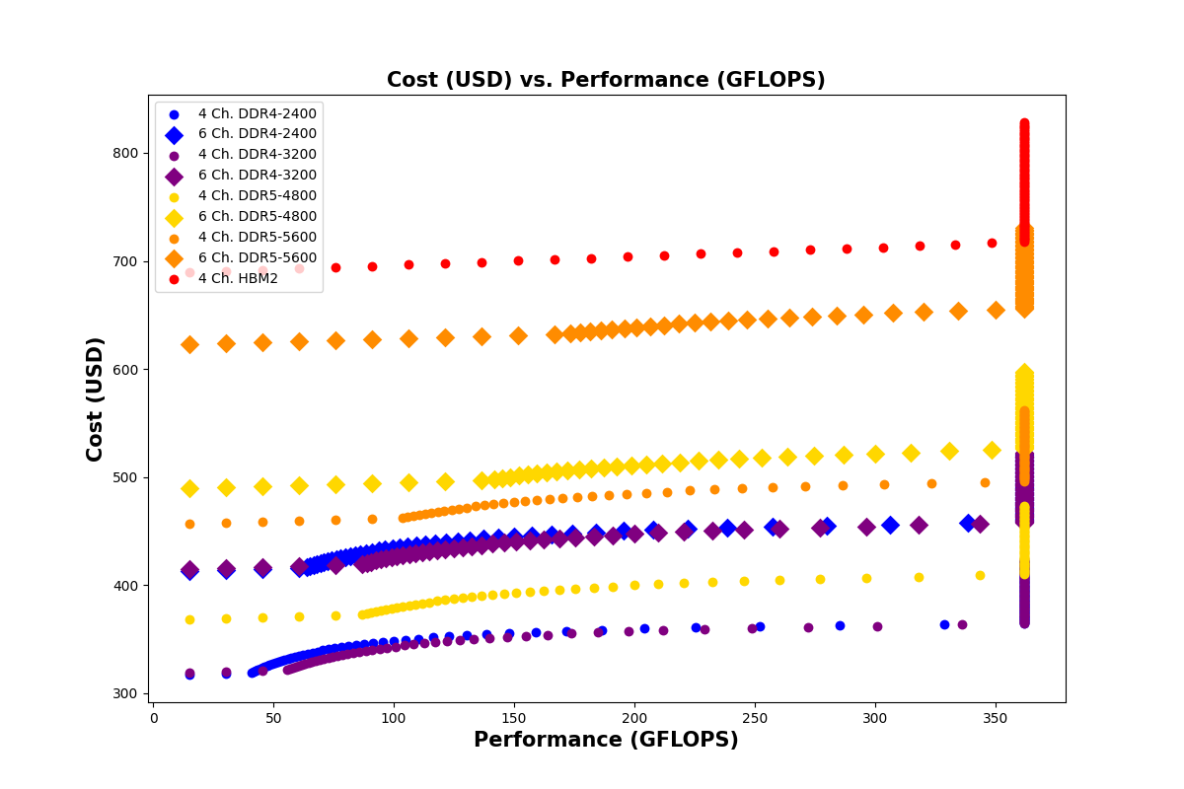
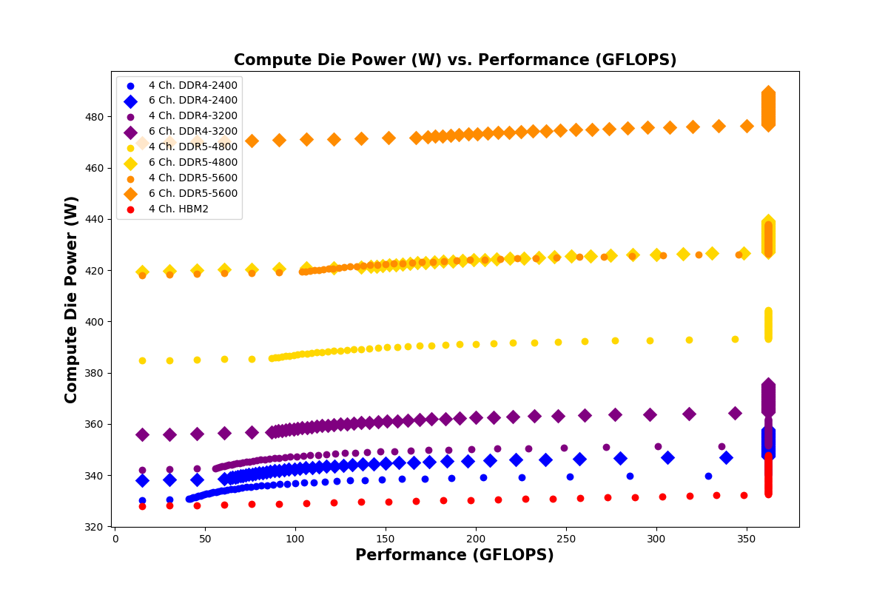
Results
Performance and Cost Trade-off
Across a range of application profiles from compute to memory intensive, we demonstrated that the reference HBM system has the highest system cost but outperforms DDR systems in compute die area, package area, and compute die power for iso-performance comparisons.
ELECTRICAL & COMPUTER ENGINEERING
GRAINGER ENGINEERING

Slide 16
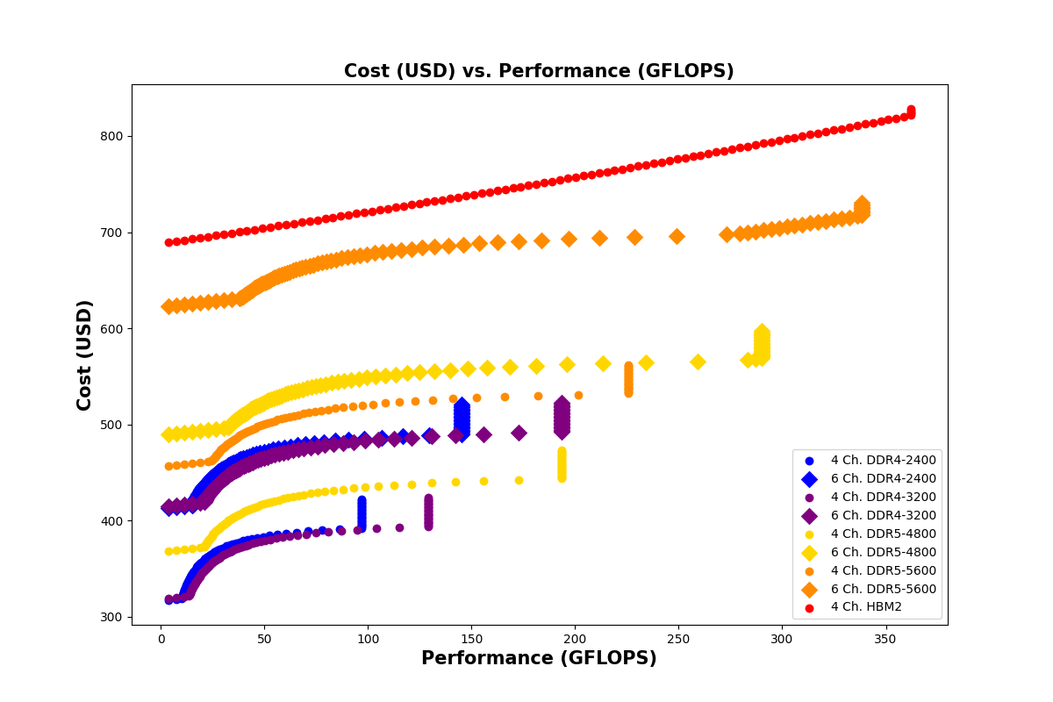
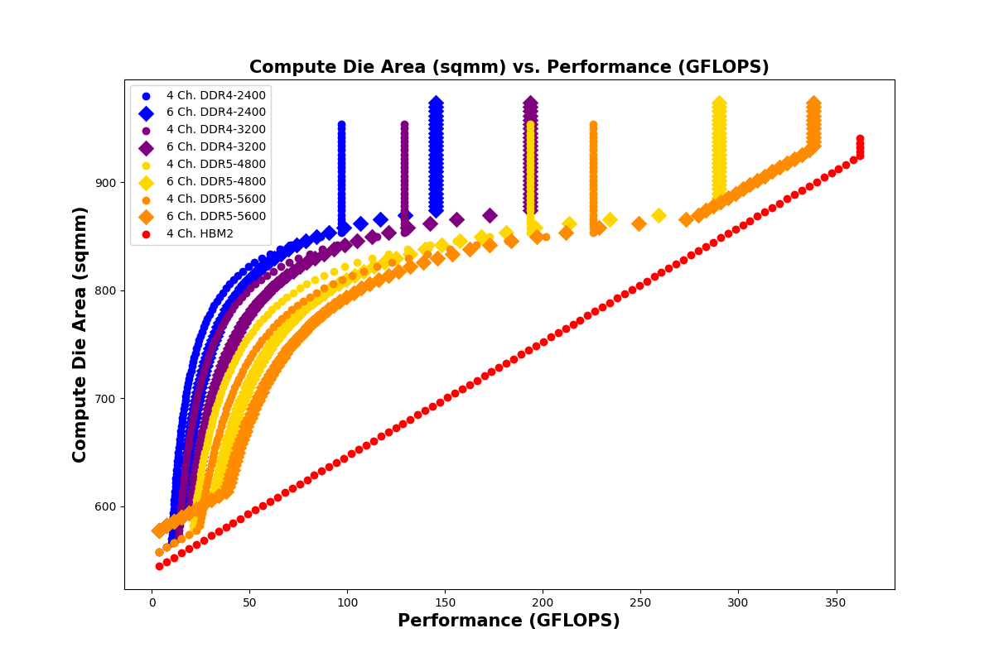
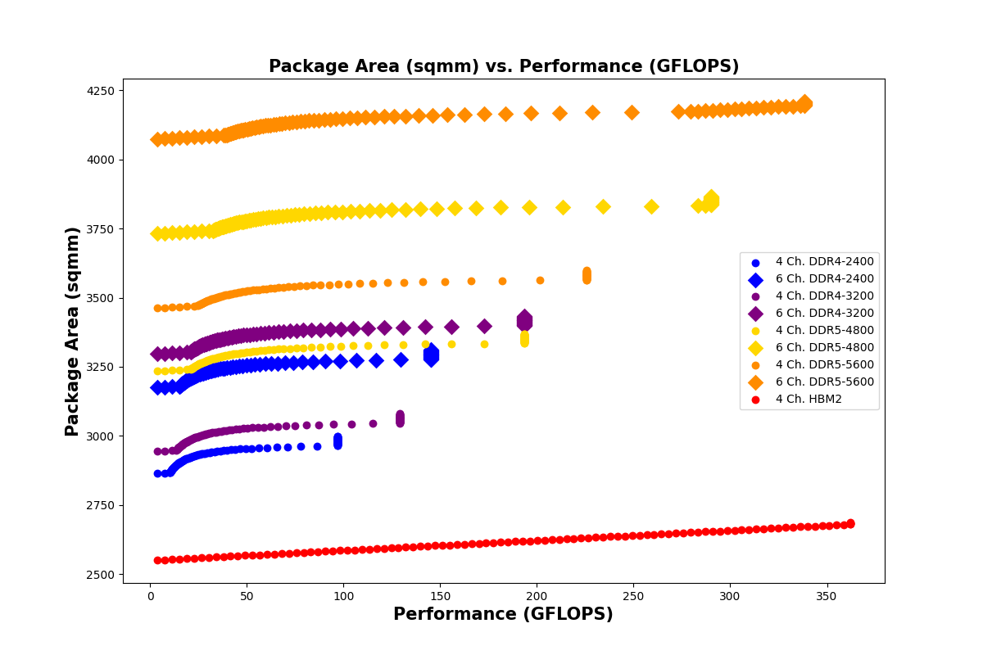
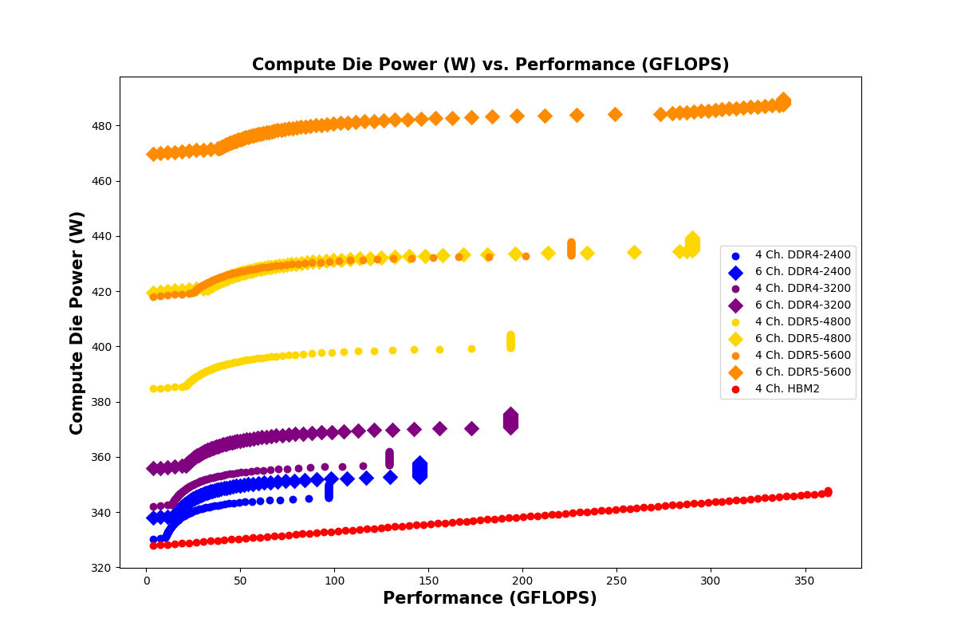
Results
Performance and Cost Trade-off (Memory-Intensive Application Profile)
Across a range of application profiles from compute to memory intensive, we demonstrated that the reference HBM system has the highest system cost but outperforms DDR systems in compute die area, package area, and compute die power for iso-performance comparisons.
ELECTRICAL & COMPUTER ENGINEERING
GRAINGER ENGINEERING
Notes:
With a more memory-intensive application, only systems with 4 channels of HBM2 memory and more than 192 MB of L3 cache are able to fully utilize the compute throughput of the compute cores.
In other words, in the memory-intensive case, there are performance levels that are only achievable by using HBM memory.

Slide 17
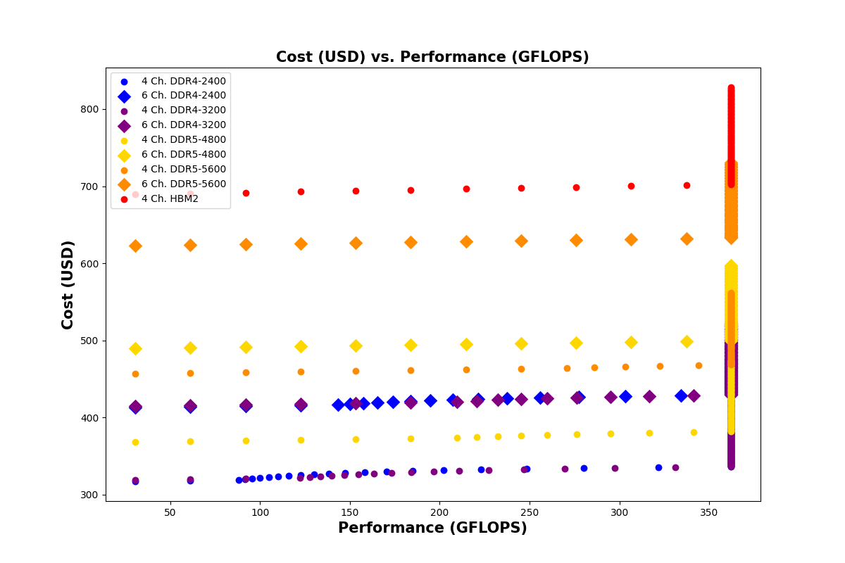
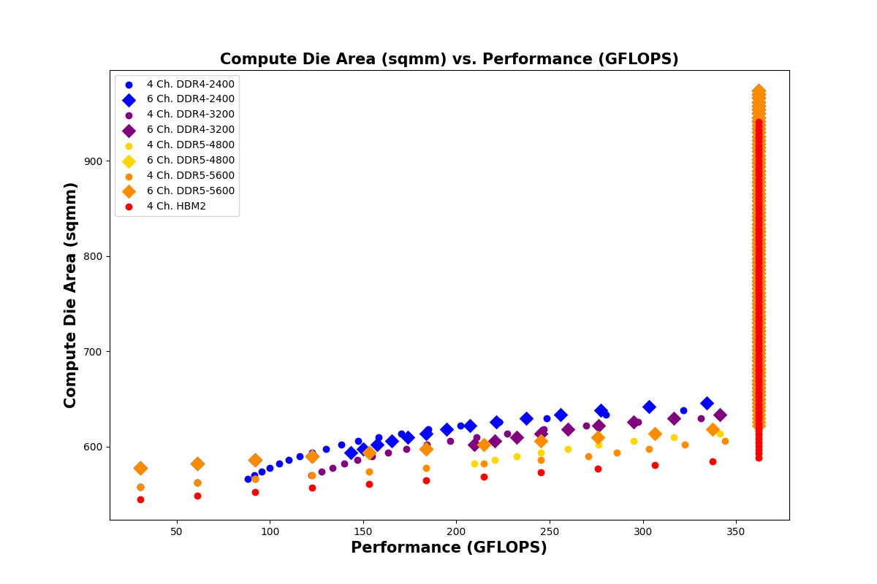
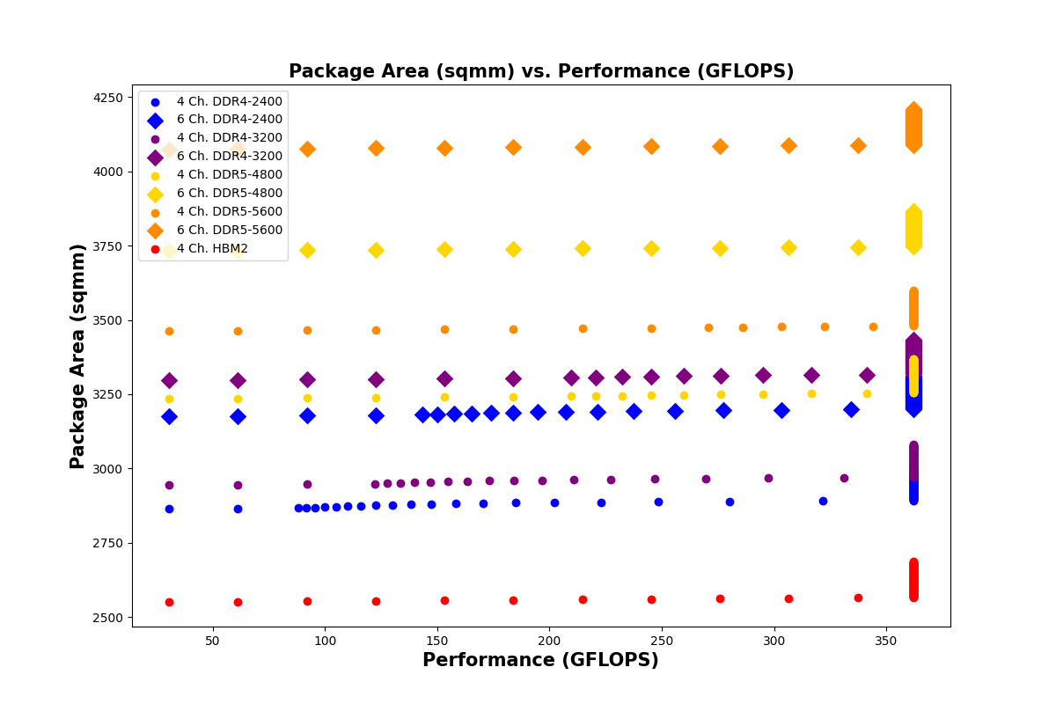
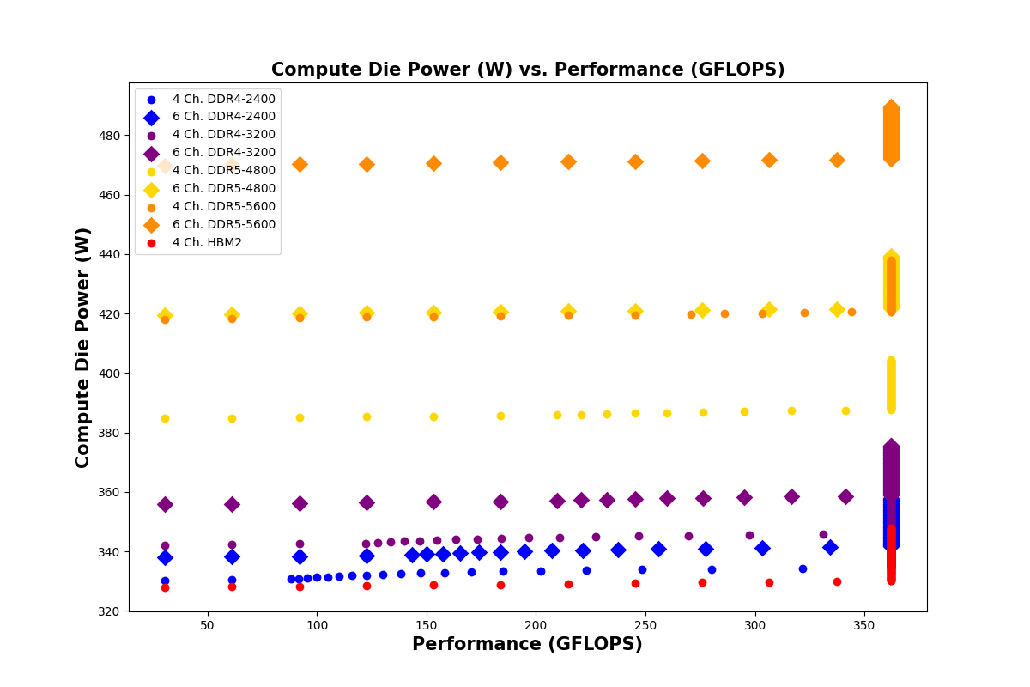
Results
Performance and Cost Trade-off (Compute-Intensive Application Profile)
Across a range of application profiles from compute to memory intensive, we demonstrated that the reference HBM system has the highest system cost but outperforms DDR systems in compute die area, package area, and compute die power for iso-performance comparisons.
ELECTRICAL & COMPUTER ENGINEERING
GRAINGER ENGINEERING
Notes:
This means there exist design points where HBM memory can be substituted with DDR memory for the same performance at a lower system cost (up to 1.97x lower) by incorporating a larger L3 cache, more memory channels, a higher memory frequency, or some combination of the three.

Slide 18
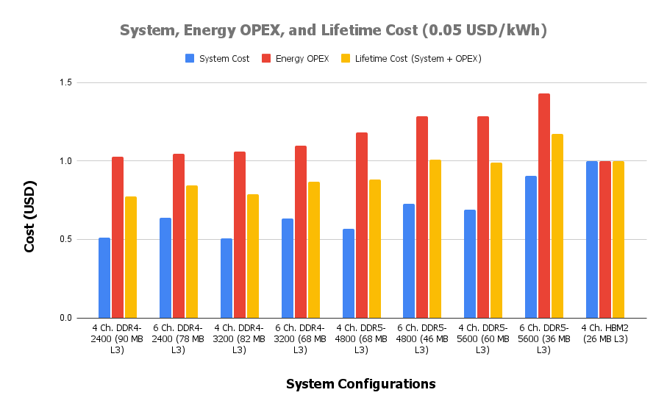
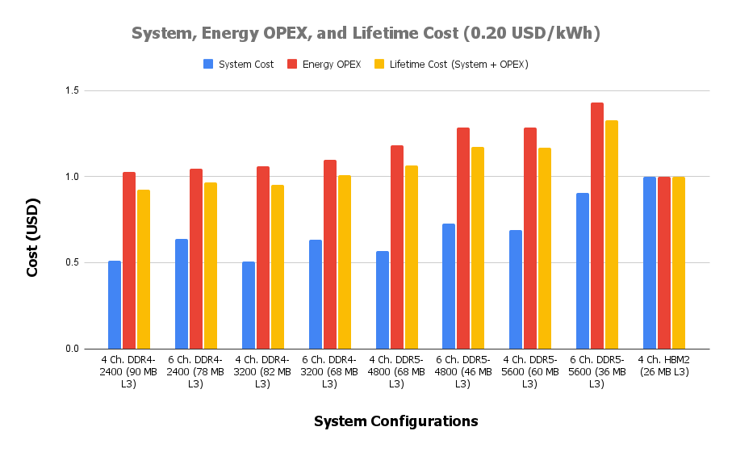
Results
Considering OPEX over System Lifetime
Since we learned that the HBM system has lower compute die power, we analyzed the OPEX over system lifetime to see if HBM system has better economics in the long term. (OPEX analysis performed @ 0.5 FLOPs/byte arithmetic intensity and 100 MB working set.)
ELECTRICAL & COMPUTER ENGINEERING
GRAINGER ENGINEERING
Notes:
The left and right graph differ in the assumed energy cost level.
The lifetime cost of the 4-channel HBM2 system is the third and sixth highest for energy costs of 0.05 and 0.2 USD/kWh, respectively. This means even when energy OPEX is considered, DDR systems, especially those running at a low frequency with a large L3 cache, still offer better economics over the system lifetime.

Slide 19
Conclusions and Future Plan
There exist design points where HBM memory can be substituted with DDR memory for the same performance at a lower system cost (up to 1.97x lower) by incorporating a larger L3 cache, more memory channels, a higher memory frequency, or some combination of the three.
This conclusion still holds even when the lifetime energy cost is considered.
However, depending on the application profile, there may be performance levels not achievable with conventional DDR memory.
Future Plan
Improve the resolution of the analytical model by considering second-order effects.
Expand the dimensions of the initial design space to include more independent variables.
Explore procurability in other subsystems other than main memory implementations.
Apply the existing DSE framework to GPU architectures where HBM memory is more commonly used.
ELECTRICAL & COMPUTER ENGINEERING
GRAINGER ENGINEERING

Slide 20


